Slide 1


Nerf-Battlebot
Red Team
Group 9
Aaron Hoyt
Daniel Agudelo
Rachel Gremillion
Rafael Ramirez
EE.
CpE.
CpE.
CpE.

Slide 2
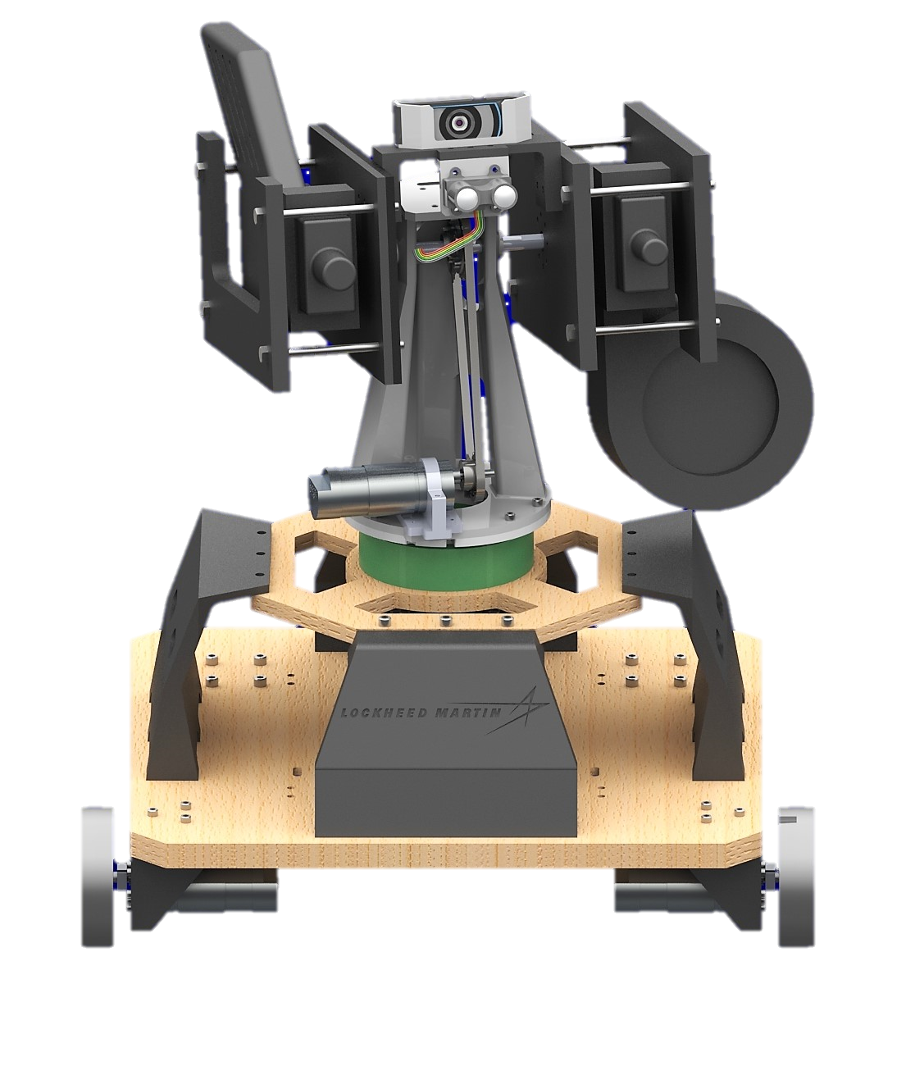
Motivation
Lockheed Martin sponsorship
Collaborate with other engineering disciplines
High quality components
Annie

Slide 3
Goals and Objectives
Design a modular system
Provide robot with powerful and precise, but also efficient movement
Processing onboard
Utilize two sensor modalities

Slide 4
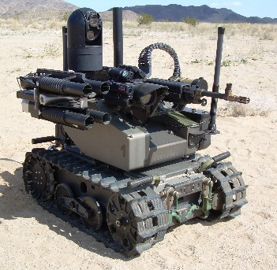


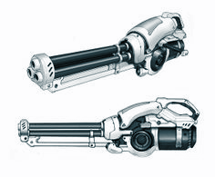
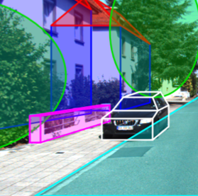
Customer Requirements
Dimensions and Mobility
Budget
Sensor
Weapon System
Target Detection
Physical Platform
& Movement
3 ft. x 3 ft. x 3 ft. (L x W x H)
Must be able to traverse battlefield
Prototyping budget of $2K
Maximum as-demonstrated cost of $1K
Use at minimum one sensor
Must acquire and fire at selected targets
Max ammo store: 50 rounds per gun
Video highlight overlay on detected targets
Wireless connection

Slide 5




Engineering Requirements
Power
Movement Speed
Targeting
Processing time
Be able to last two 10 minute rounds
Be able to obtain a minimum speed of 1.0 ft/s
Detect and hit 2ft. x 2ft. targets from max range of 40 ft.
Be able to detect and fire upon target within a 3 second time frame

Slide 6
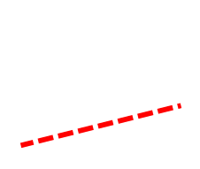
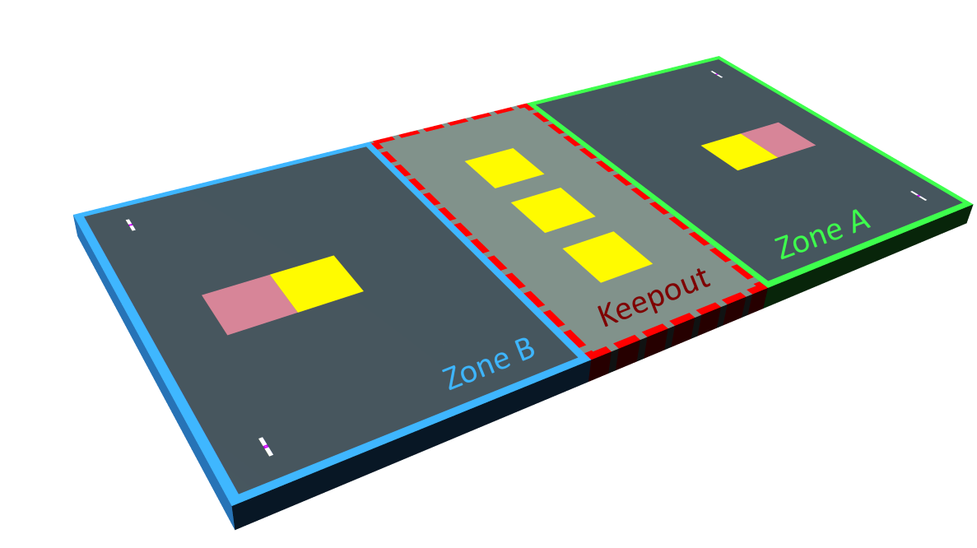
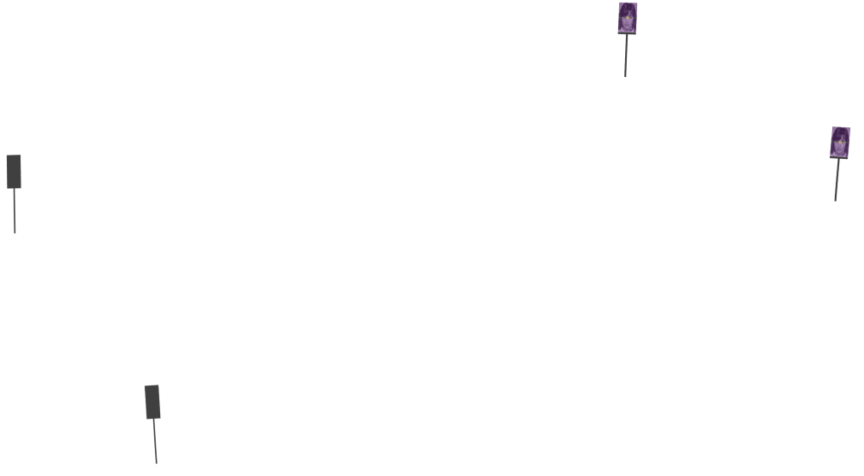

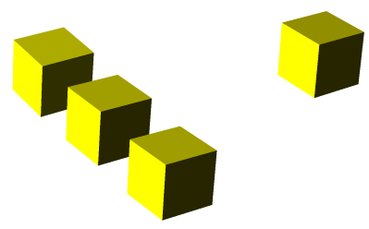
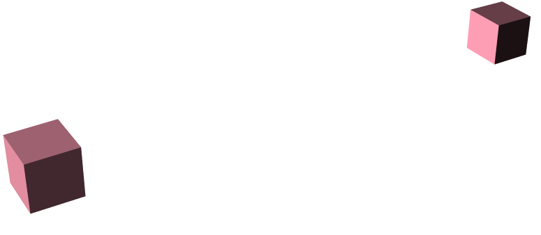



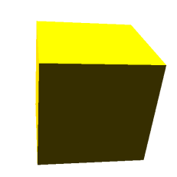


Competition
15ft.
10ft.
15ft.
20ft.
40ft.
Obstacles
Start
Target

Slide 7
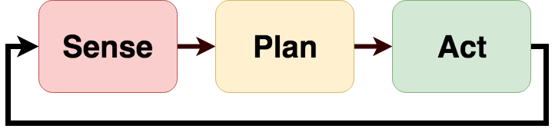
Robot Architecture
Deliberative paradigm
Find all targets
Distinguish target type
Fire upon appropriate targets

Slide 8
Final Design

Slide 9
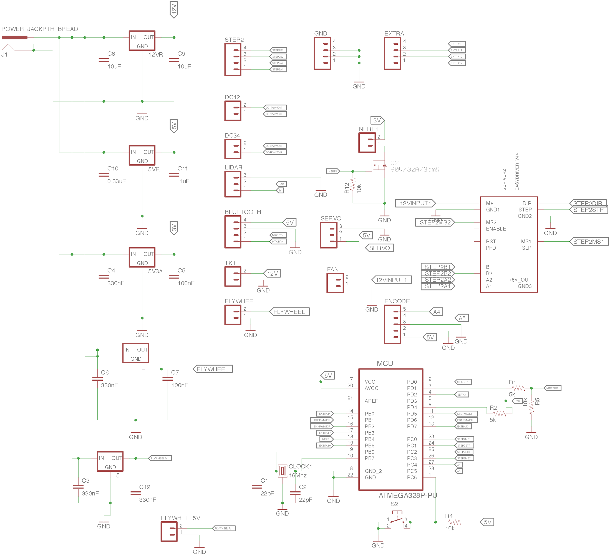
PCB Schematic

Slide 10
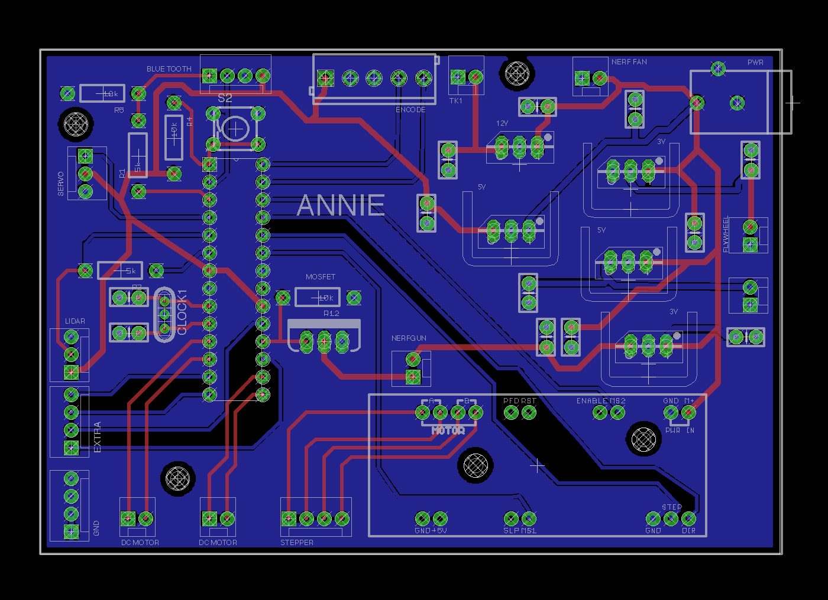
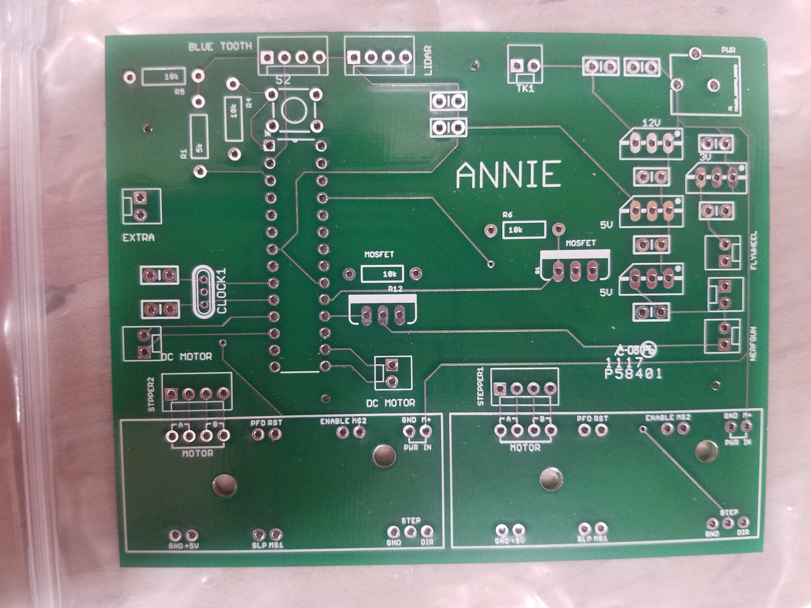
PCB Design and Assembly
Power ports for various systems
ATMega328p MCU
Bluetooth
Lidar Connection
Encoder input
Nerf Blaster MOSFET switching
PCB before Assembly
Board Layout in EagleCAD

Slide 11
Hardware Selection

Slide 12
Sensors

Slide 13
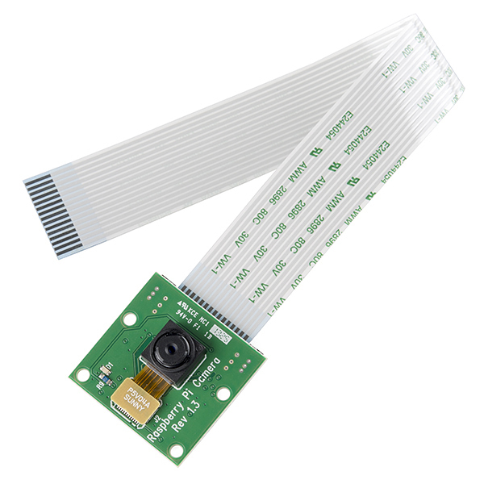
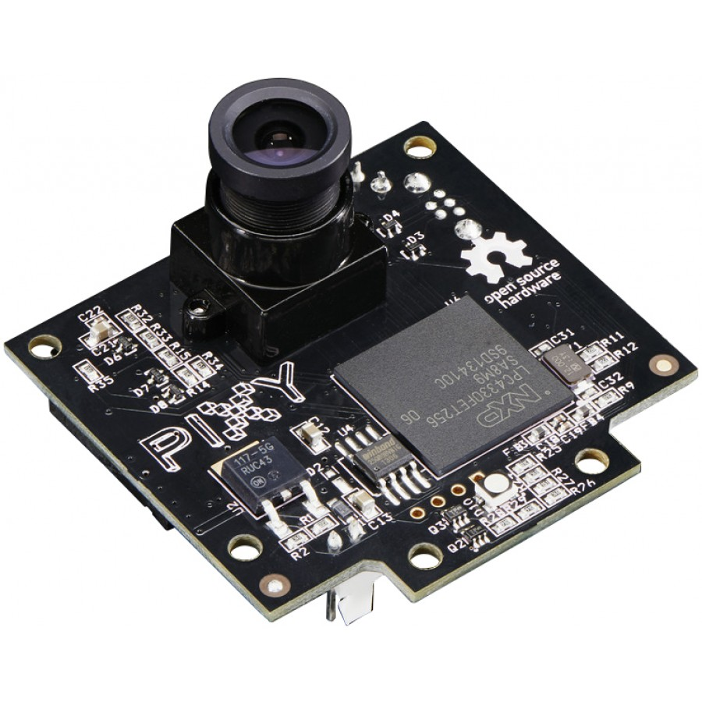
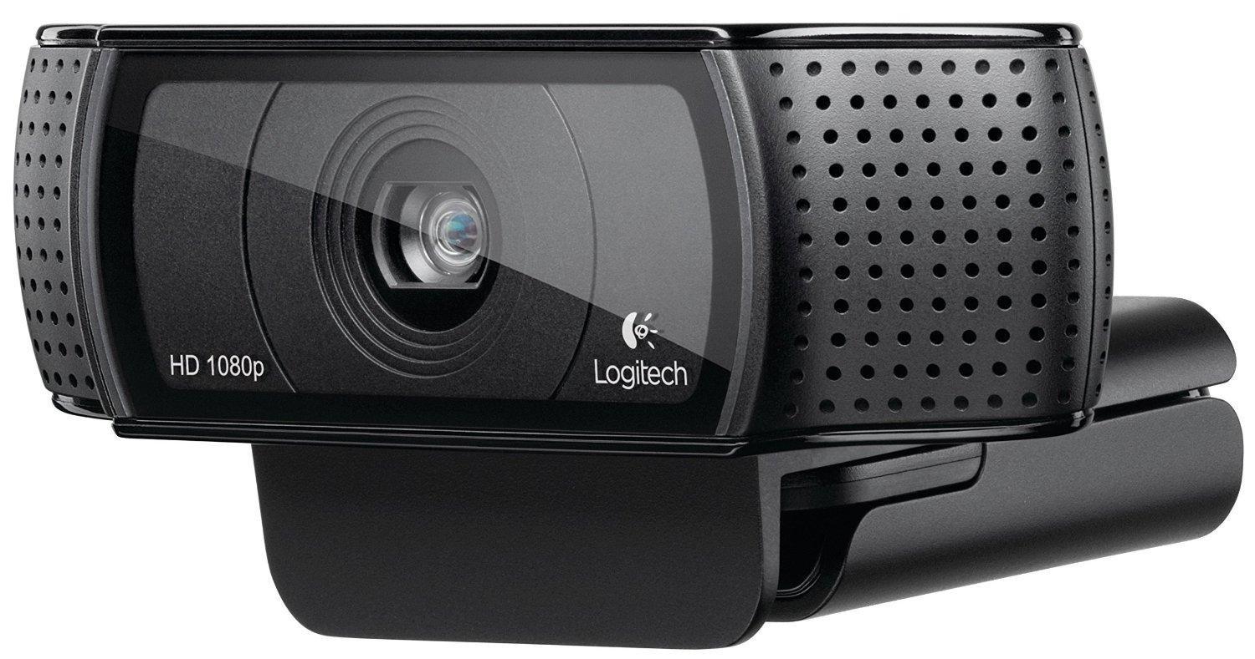
Camera Selection
Logitech C920 Webcam
Raspberry Pi Camera Module v2
Pixy CMUcam5
• $52.49
• 1080p
• 6 ft USB
• 7 x 4.8 x 9.2 cm
• 70 x 43 FOV
• $25.00
• 1080p
• Ribbon Cable
• 2.5 x 2.4 x 0.9 cm
• 62 x 48 FOV
• $67.00
• 800p
• Multiple plugins
• 5.3 x 5 x 3.6 cm
• 75 x 47 FOV

Slide 14
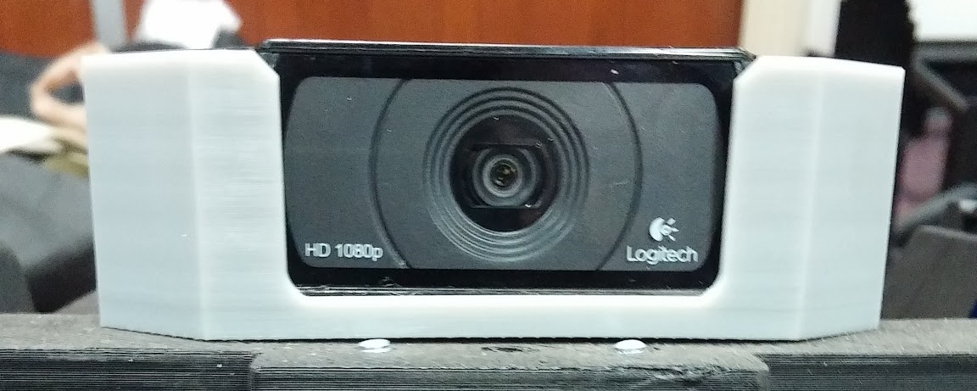
Logitech C920 Webcam
Video compression
1080p Video Recording
6 ft. USB cable
Make | Angle of View | Resolution | Frame Rate | Price ($USD)
Logitech HD Pro Webcam C920 | 70 x 43 | 1920 x 1080 | 30 | $58

Slide 15
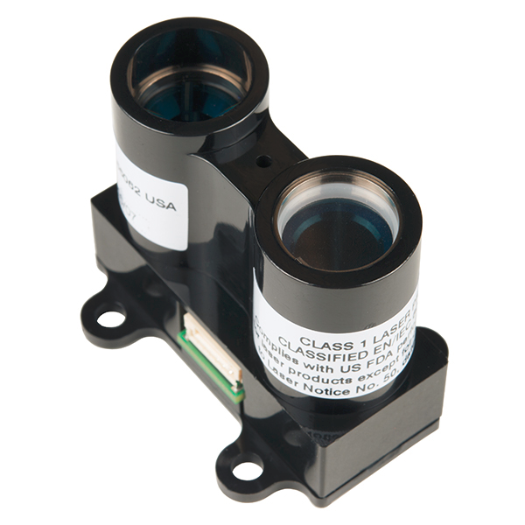
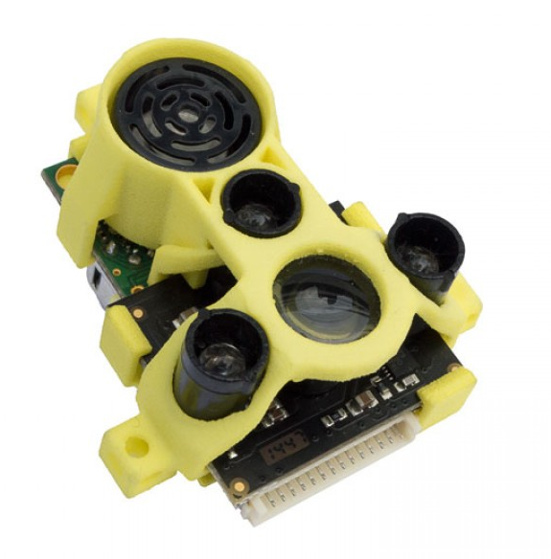
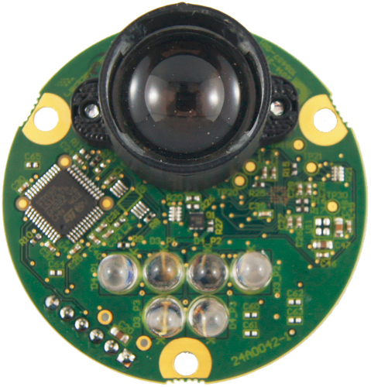
Rangefinder Selection
LIDAR-Lite v3
TeraRanger Duo
LeddarTech Leddar One
• $149.99
• 131 ft
• +/- 2.5 cm
• 2 x 4.8 x 4 cm
• $207.20
• 46 ft
• +/- 2 cm
• 5.3 x 4.4 x 2.5 cm
• $115.00
• 49 ft
• +/- 5 cm
• 2” in diameter

Slide 16
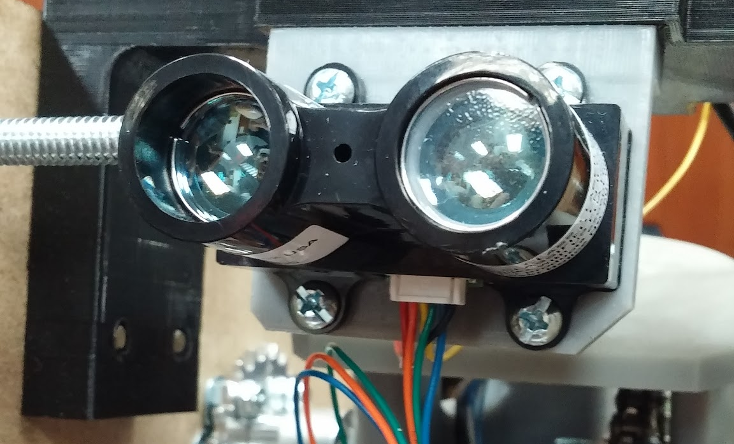
Lidar-Lite 3 Rangefinder
Longest Range
Accuracy
Affordable
Make | Size | Max Range | Accuracy | Price ($USD)
LIDAR-Lite 3 Laser Rangefinder | 2 ✕ 4.8 x 4 cm | 131.23 ft | +/- 2.5 cm | $149.99

Slide 17
Processing Units

Slide 18
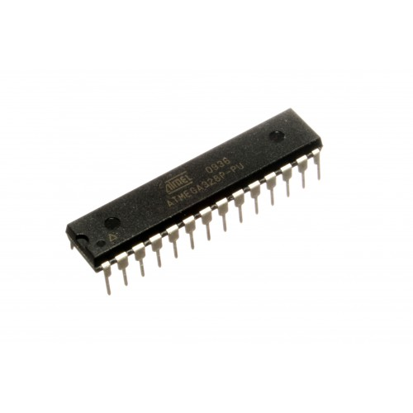
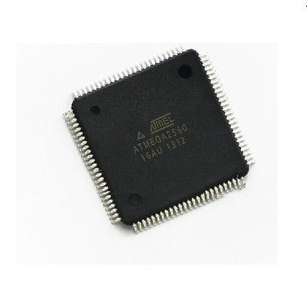
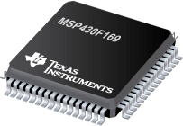
Microcontroller Selection
ATmega 328p
ATmega 2560
MSP430F169
• 8-bit AVR RISC
• 32KB Flash
•1.8 - 5V Operating
• 1-UART, 1-I2C, 2-SPI
• 28 pins, 14 digital, 6 analog
• 8-bit AVR RISC
• 256KB Flash
• 4.5 - 5.5V Operating
• 2-UART, 3-SPI, 1-I2C
• 64 pins, 54 digital, 10 analog
• 16-bit
• 60KB Flash
• 1.8 -3.6V Operating
• 2-UART, 1-I2C
• 48 GPIO

Slide 19
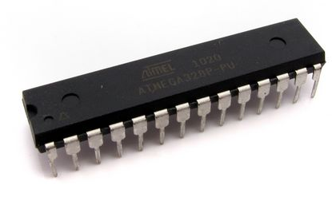

ATMega328P
Purpose
  Main control unit
  Used to control motors
  Digitally triggering Nerf-Blasters
  Receiving input from sensors
Specifications
14 Digital I/O pins
  6 PWM pins
6 Analog input pins
Operating Voltage: 5V
Input Voltage: 6-20V
16MHz clock speed
ATmega328p

Slide 20
Initial Complications
Device overload
  Insufficient pin availability
    Reduce functionality to reduce pin count
  Potential processing delay
    Sending commands to multiple devices simultaneously
Dual ATmega328p
  Split performance load
  Increase complexity via device communication

Slide 21
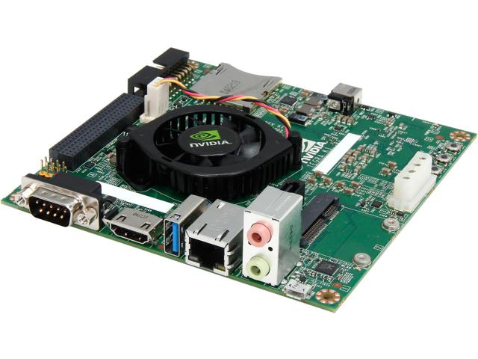
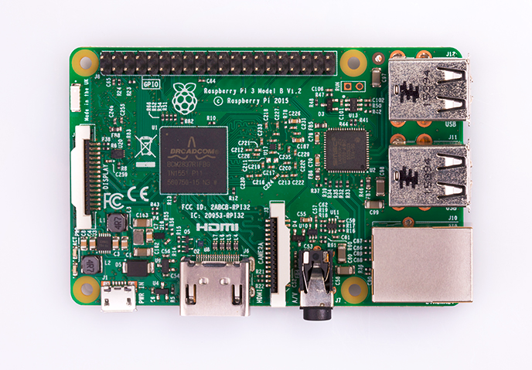
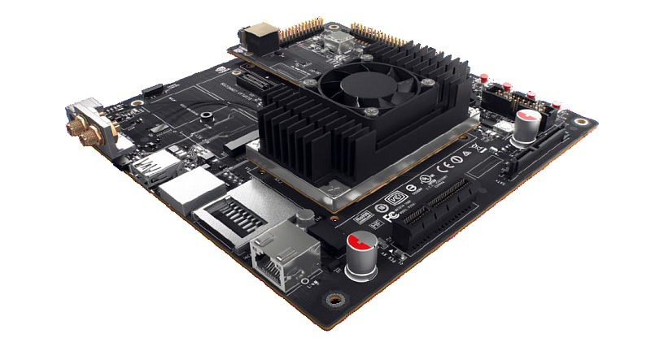
Microprocessor Selection
NVIDIA Jetson TK1
Rasberry Pi 3 Model B
NVIDIA Jetson TX1
• $129
• 2.3 GHz
• Quad Core
• OpenCV
• 2GB RAM
•$35.69
• 1.2GHz
• Quad Core
• Grade Level Processing
•$300
• 256-core Maxwell
• Quad Core
• OpenCV
• 4GB DDR4

Slide 22
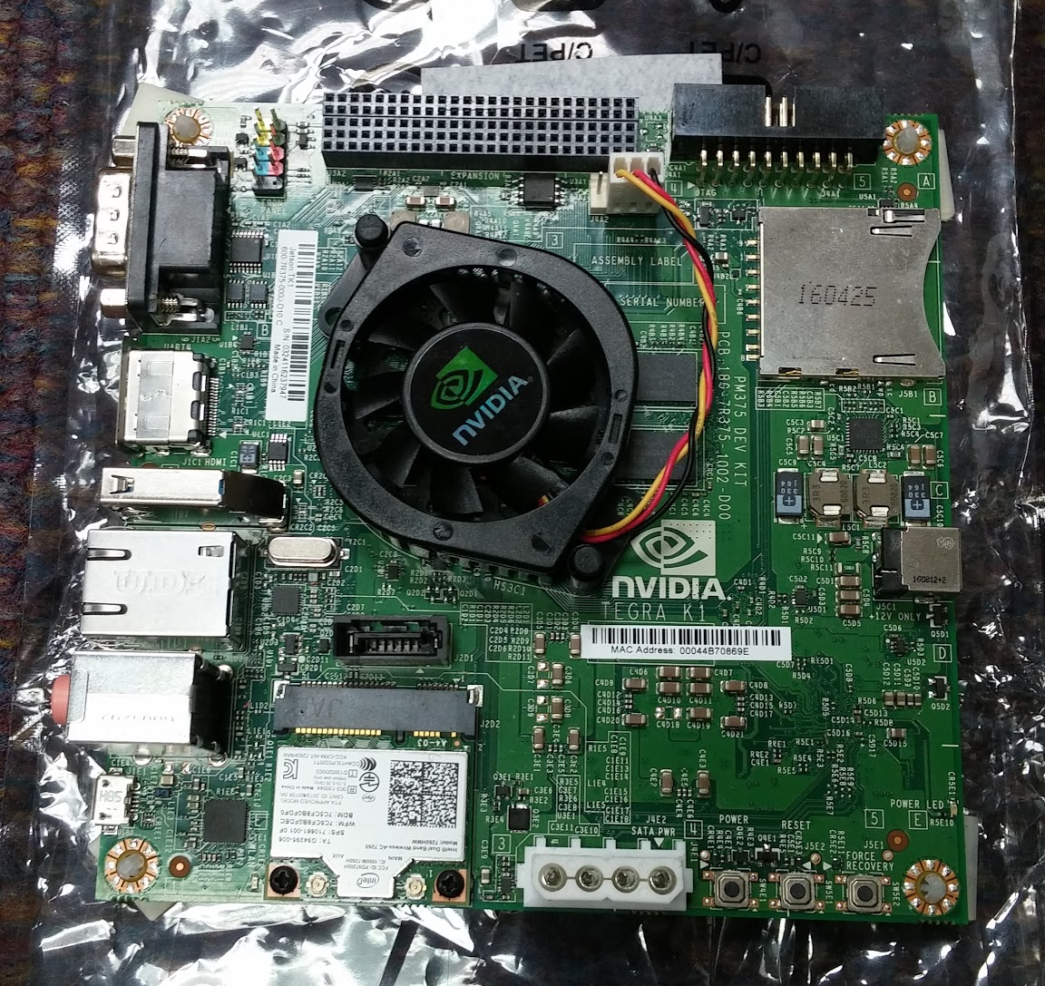
Jetson TK1
Purpose
  Run automated targeting algorithms and image processing
  Input and output relay from and to microcontroller
  Wireless communication to controller for manual navigation
Specifications
2.3 GHz 4 plus 1 CPU
2GB RAM
GPU optimized for OpenCV
  192 CUDA Cores
NVIDIA Jetson TK1

Slide 23
Motors and Drivers

Slide 24
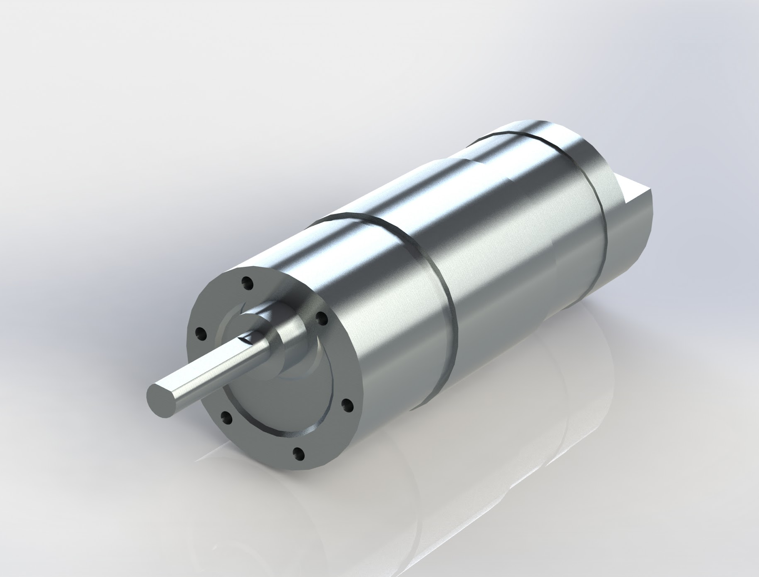
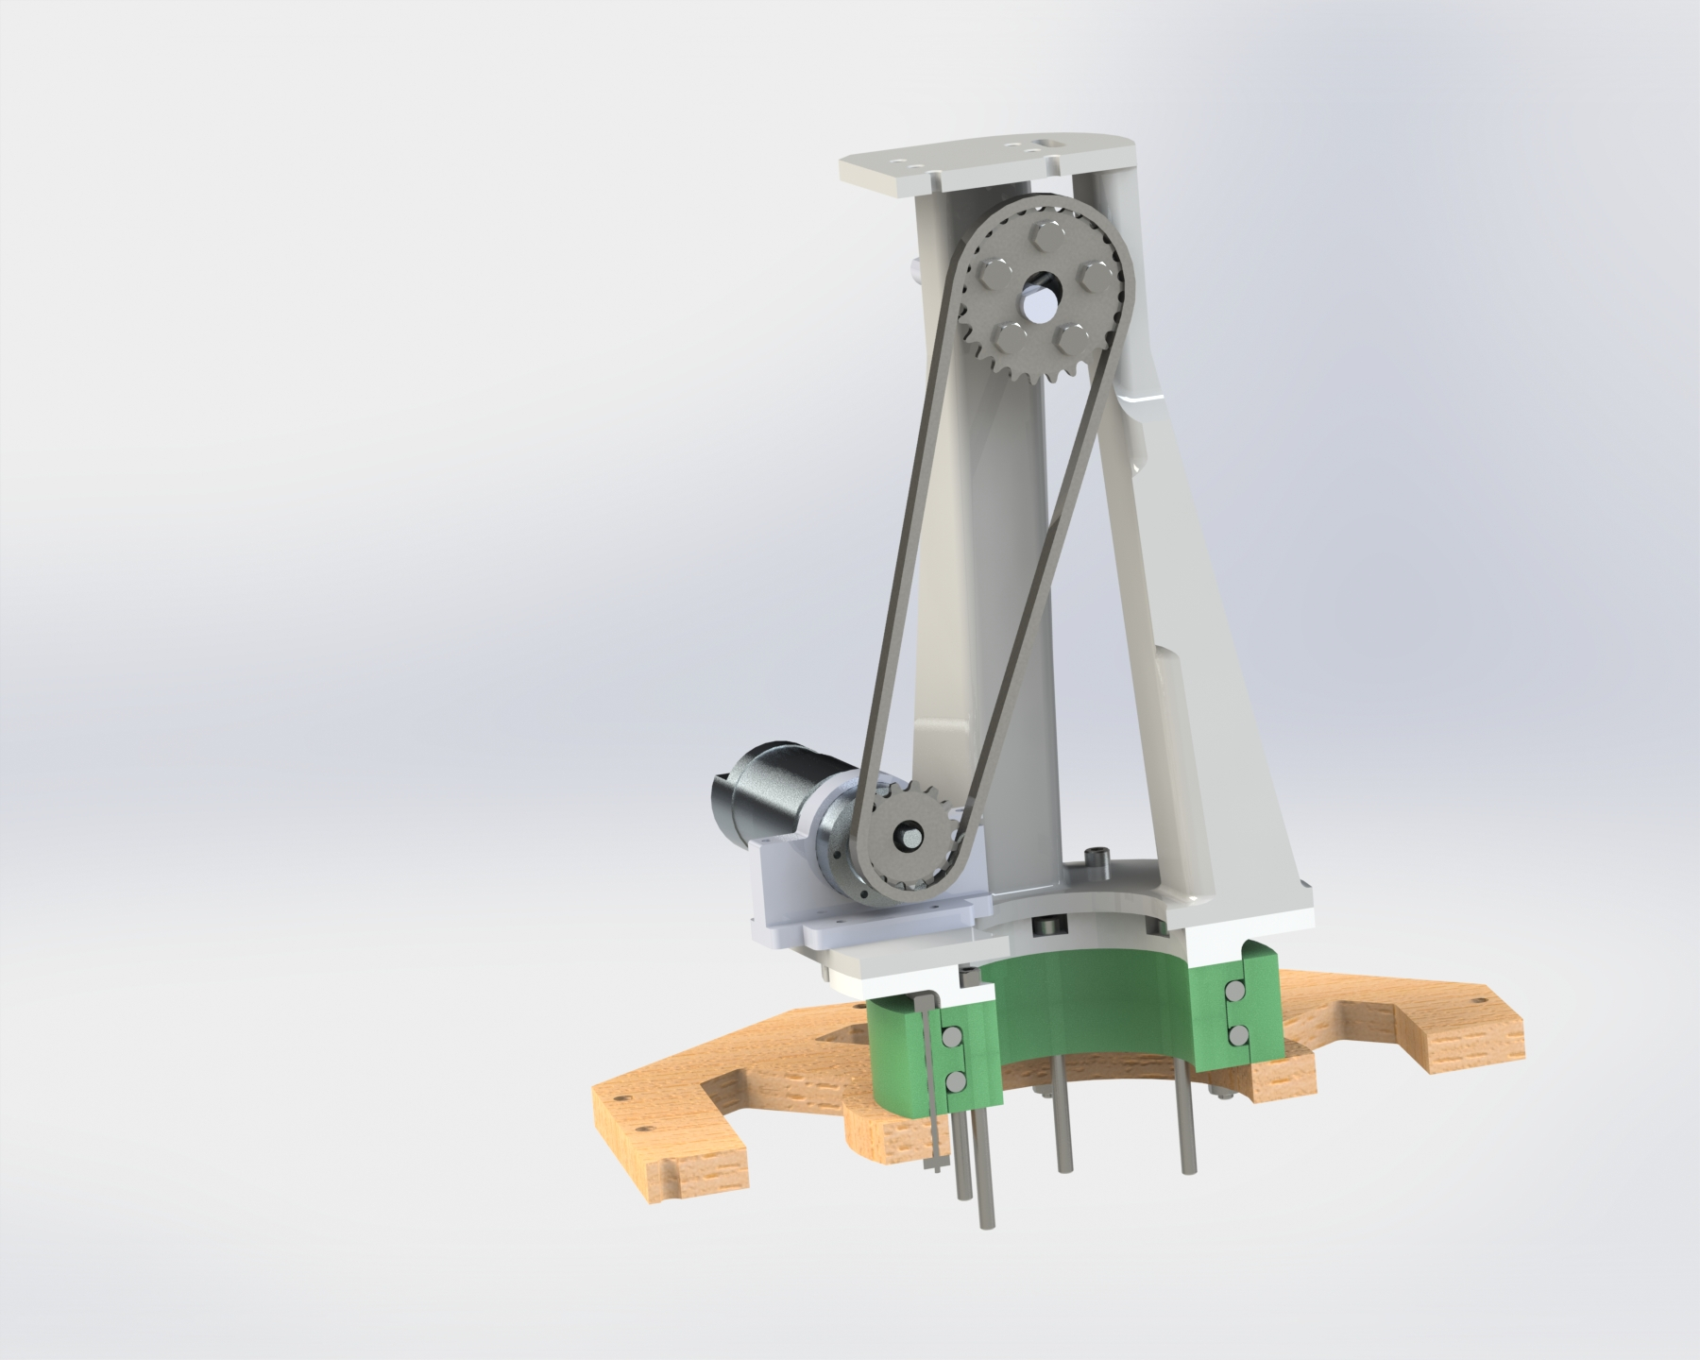
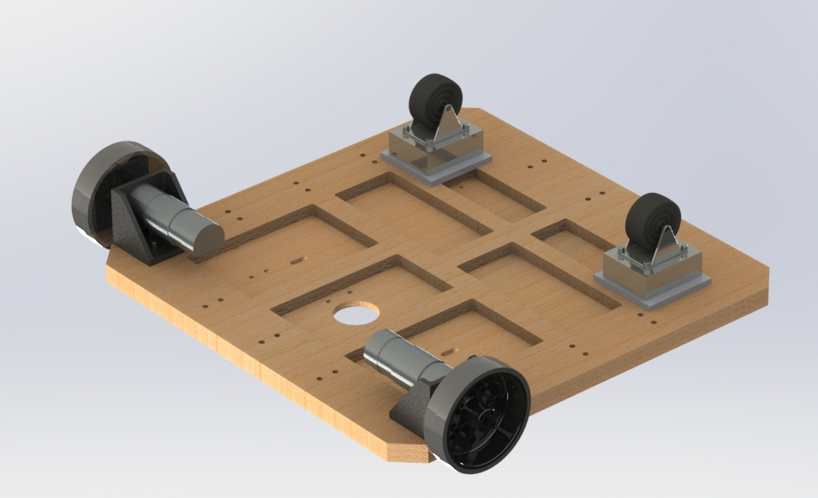
Motor Selection
DC Motors
Battlebot manual navigation
Pan/Tilt of Turret System
Maximum velocity of 3.3ft/s using four motors
Equipped with Encoders
Operating at 12V, 1.3A
NeveRest 40 Gearmotor
Turret Location
Drivetrain Location

Slide 25
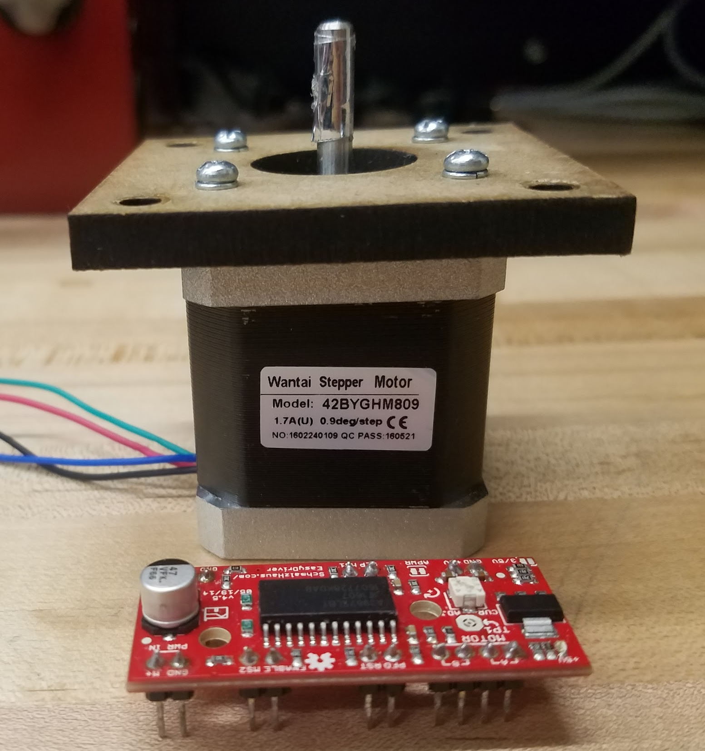
Initial Motor Selection
Stepper Motors/Drivers
Utilizing A3967SLB Chip
.9 degrees per step
Two logic inputs allow for full, half, quarter, and eighth step
Did not provide enough current to rotate optical mount
Stepper Motor and Driver

Slide 26
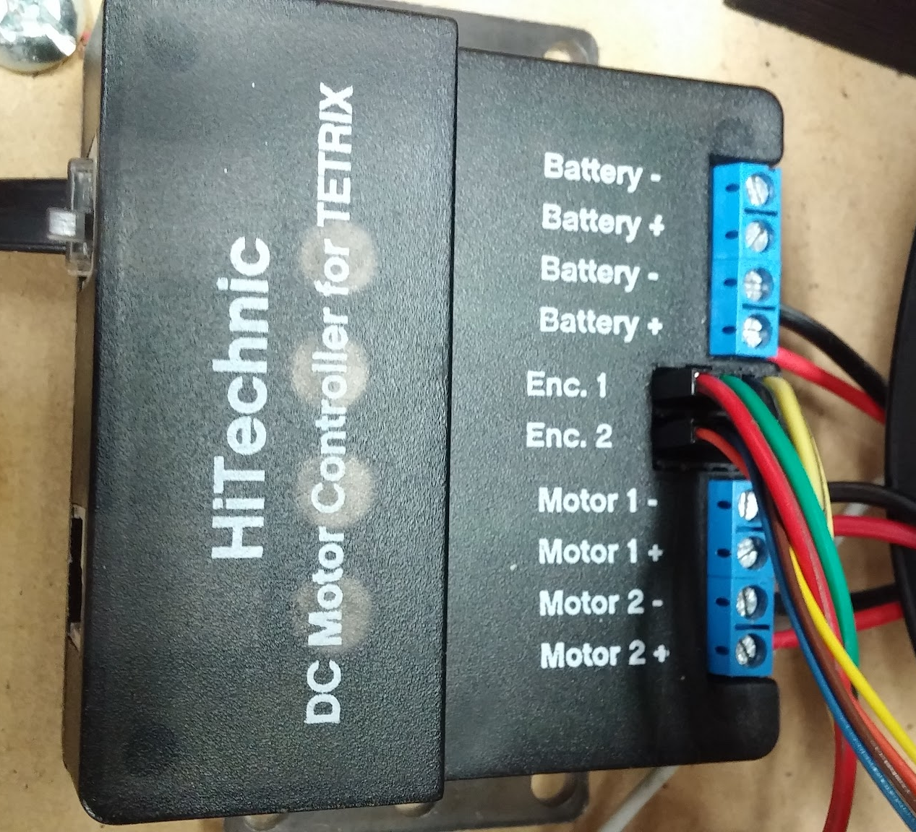
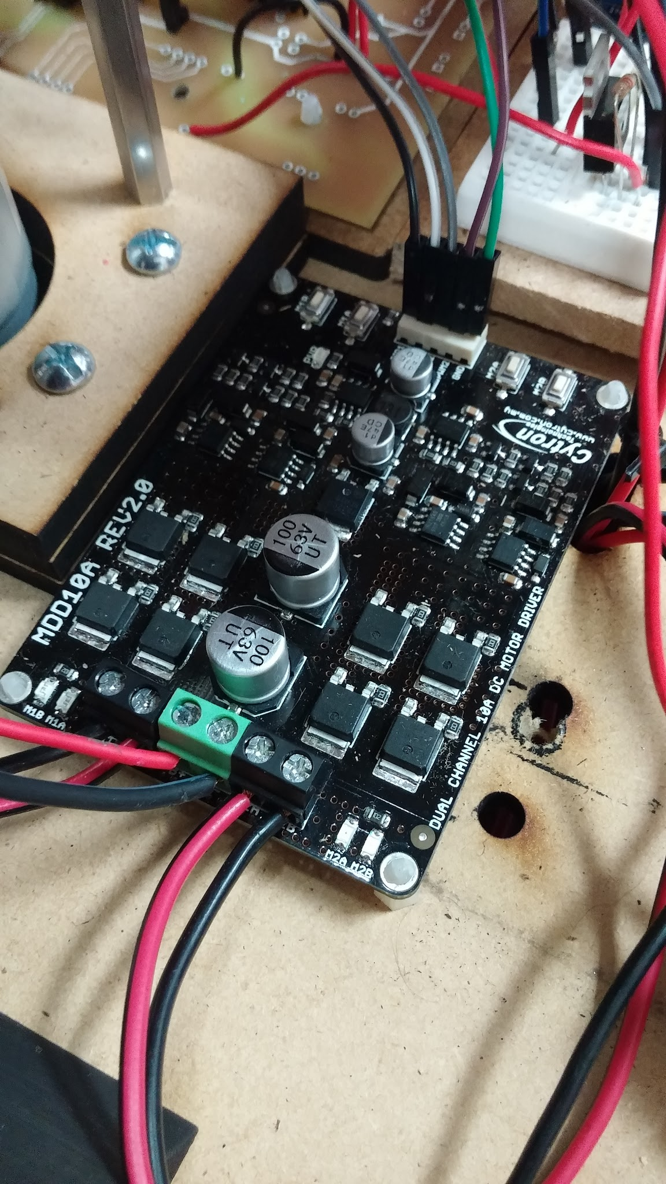
Motor Drivers
HiTechnic DC Motor Controller
Cytron DC Motor Driver
Equipped with Encoders
Supplies up to 4A with 9-15V input
Provides I2C Communication
Used for Pan/Tilt of Turret System
10A 5-25V Dual Channel Controller
DC Motors: 12V, 1.17A
Bi-directional control
Used for Manual Navigation of System

Slide 27
NERF-Blasters

Slide 28
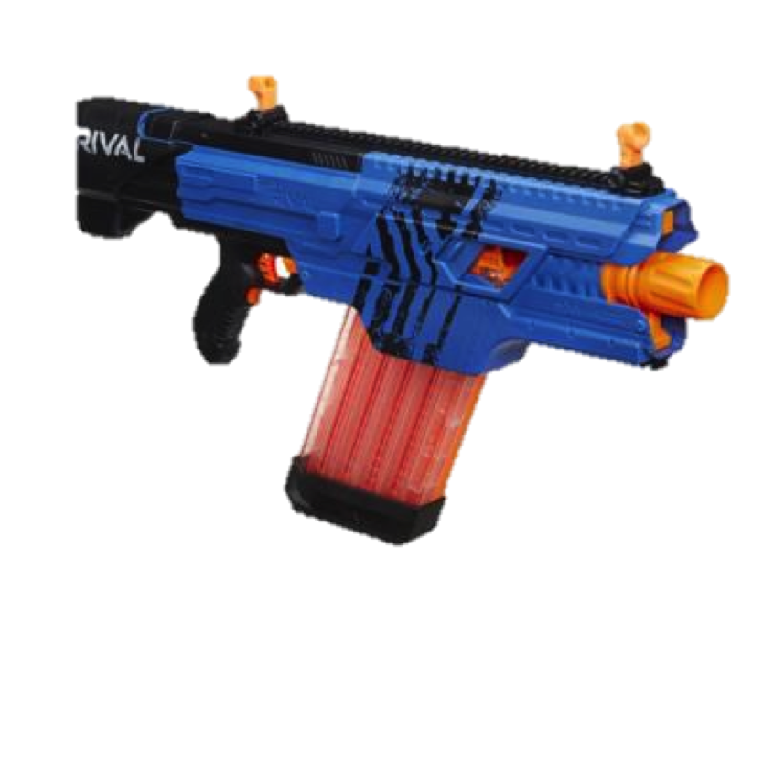
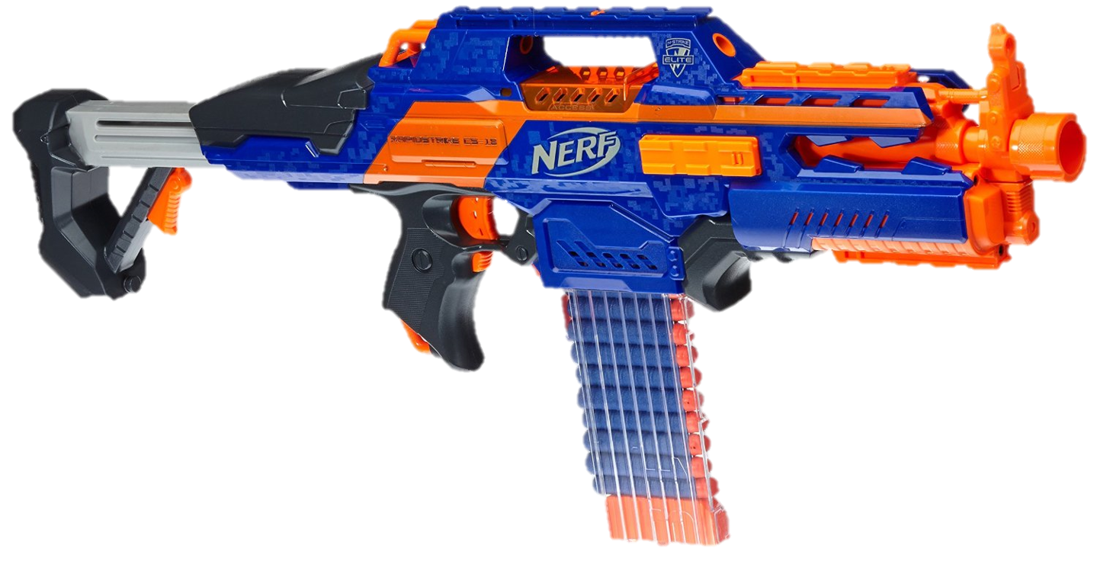
NERF-Blasters Selection
Name | Ammo Type | 0-Angle Range | Velocity | Price
Rival Zeus MXV-1200 Battle Gun | Ball | 65-75 feet | 100 feet/second | $39.99
Rival Khaos MXVI-4000 | Ball | 65-75 feet | 100 feet/second | $62.99
N-Strike Elite Rampage | Dart | 50 feet | 50 feet/second | $31.99
Rapidstrike CS-18 | Dart | 55 feet | 75 feet/second | $39.99
Rapidstrike CS-18
Rival Khaos MXVI-4000

Slide 29
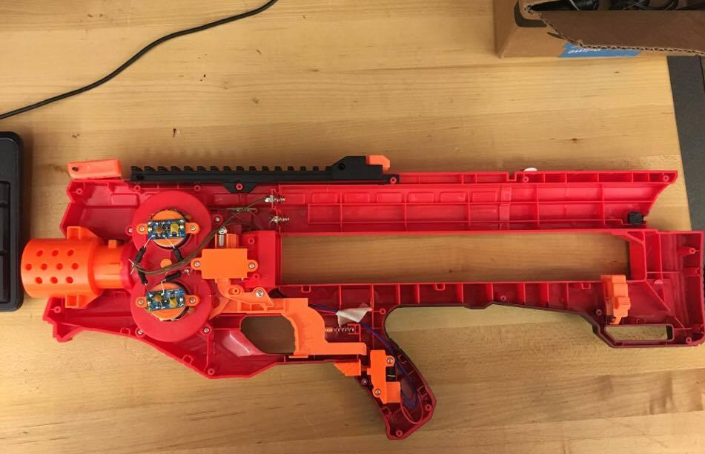
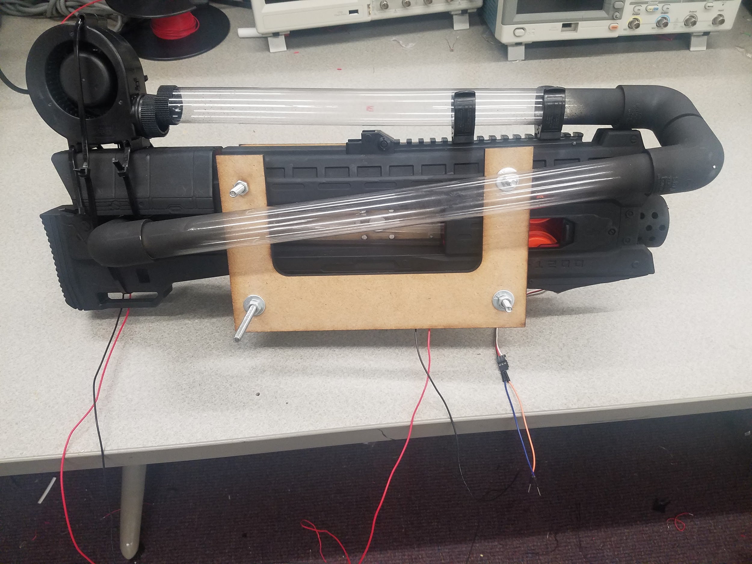
Initial Nerf Blaster Selection
Rival Zeus MXV-1200
  50 Nerf Balls with Custom Feeder
  Operated via ATMega328P using Fan and Servo Motor
  Fan required high voltage to feed ammo
  Special latch needed for ball to release from barrel
Inside the Rival Zeus MXV-1200
Modification of Rival Zeus MXV-1200

Slide 30
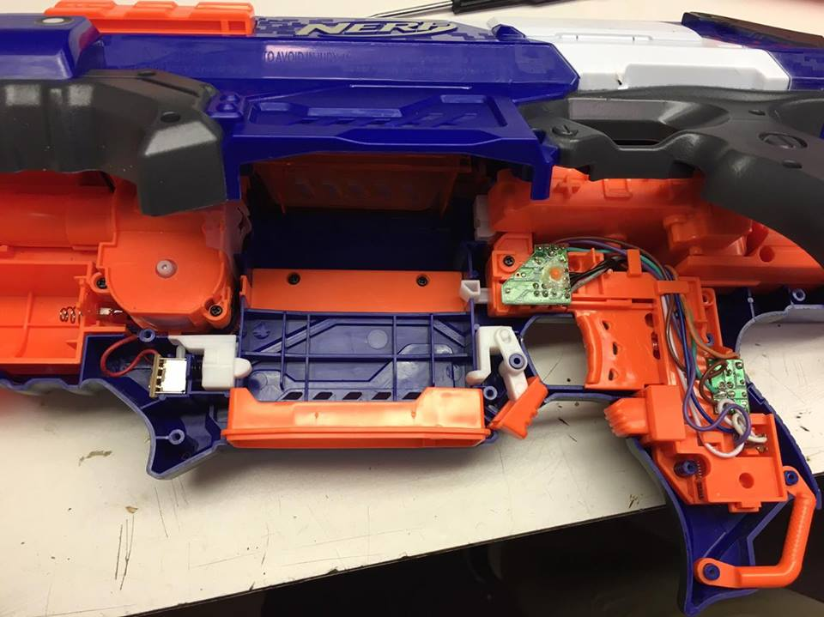
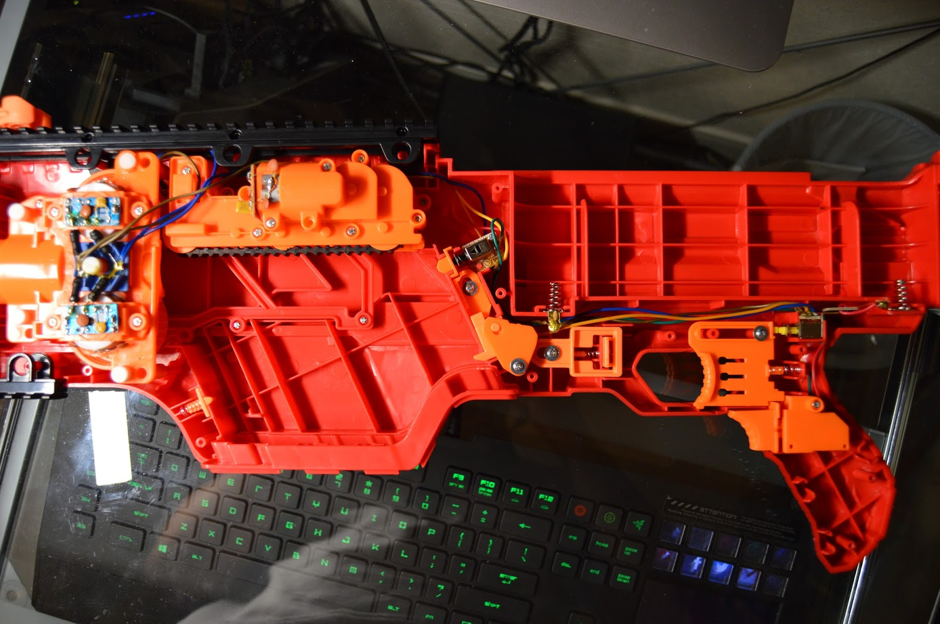
NERF-Blasters Integration
Rapidstrike CS-18
Power: 6V, 1.5A
Utilizes two motor systems
Rival Khaos MXVI-4000
Power: 9V, 1.5A
Utilizes two motor systems
Rapidstrike CS-18
Rival Khaos MXVI-4000 Battle Gun

Slide 31
Power

Slide 32
Power Consumption
Component | Quantity | Voltage(V) | Total Current(mA) | Mostly On/Off | Power(W)
Microcontroller | 1 | 5 | 46.5 | ON | 0.23
DC Motor | 4 | 12 | 4800 | OFF | 57.60
Nerf-Blaster (Darts) | 1 | 6 | 1500 | OFF | 9.00
Nerf-Blaster (Ball) | 1 | 9 | 1500 | OFF | 13.50
Jetson TK1 | 1 | 12 | 2500 | ON | 30.00
LIDAR Lite | 1 | 5 | 130 | OFF | 0.65
Total Power |  |  |  |  | 110.98

Slide 33
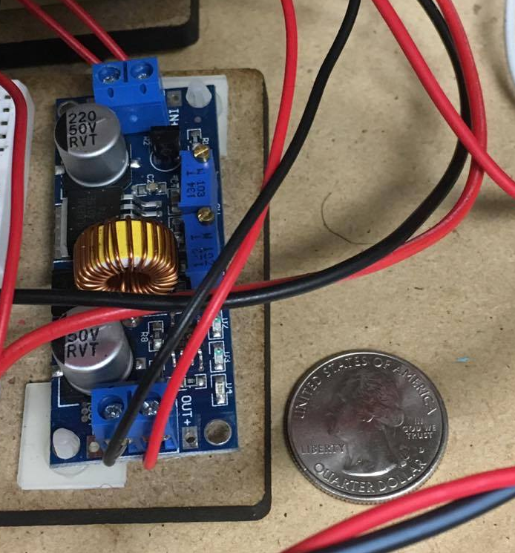
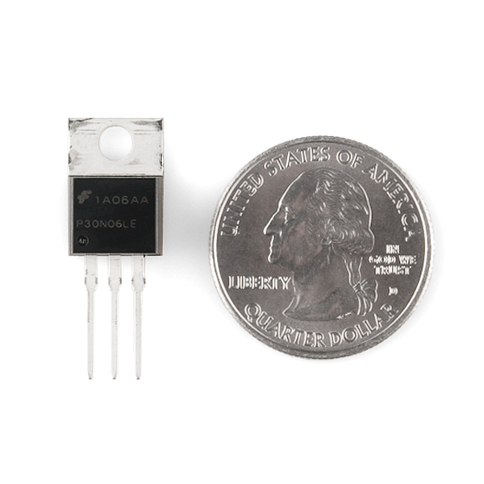
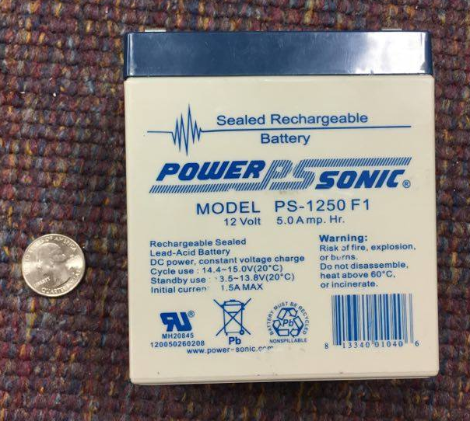
Power Selection
Sealed Lead Acid Battery
Drok DC-DC Step Down Variable Regulator
N-Channel MOSFET
Two power systems
12V, 5 aH
15 minute run time per charge
Provides constant voltage and current
Short circuit protection
Low voltage on-switching
Supports circuits up to 60V and 30A

Slide 34
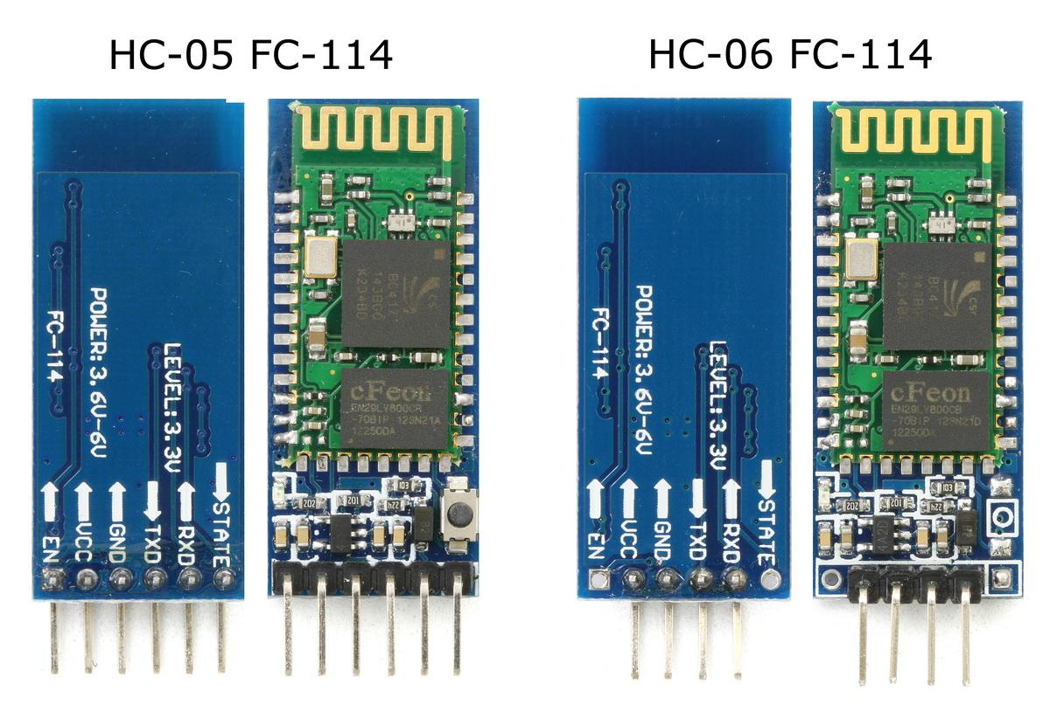
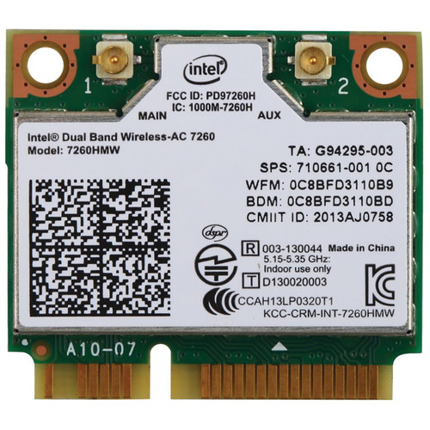

Communication Hardware
Onboard Processing
HC-06 Bluetooth v2.0 Full Duplex Frequency: 2.4 GHz Data Transfer Speed: 921.6 kbps TTL Serial Operating at 3.3V 8ma
Remote Workstation
Intel Dual Band Wireless WiFi, Bluetooth PCIe Remote Control Upstream video feed
Bluetooth Module HC-06
Intel Dual Band Wireless-AC 7260

Slide 35
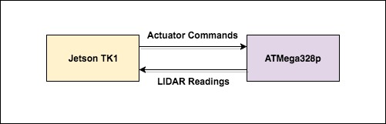
Serial Communication
Purpose
Send actuator commands from Single Board Computer to MCU
Send LIDAR readings from MCU to Single Board Computer for processing
Software
POSIX Terminal Serial Interface
Arduino Serial
RFCOMM Bluetooth Protocol
Serial Port Configuration
Asynchronous Serial
Baud rate: 115200
Character Size: 8 bits
Parity: 0 bits
Stop: 0 bits
Non-Canonical Mode

Slide 36
Software Involvement
Deliverables
Manual Navigation
Turret Control
LIDAR Sensor Readings
Nerf Blaster Triggering
Assistance
Integration

Slide 37
Administration

Slide 38
Work Distribution
 | PCB Design | Motor Control | Sensors | Firing System | Communication | Software
Aaron H. | ✘ | ✘ |  | ✘
Daniel A. |  |  | ✘ |  | ✘ | ✘
Rachel G. | ✘ | ✘ |  |  |  | ✘
Rafael R. |  |  | ✘ |  | ✘ | ✘
Notes:
Change the columns. It’s just a template.

Slide 39
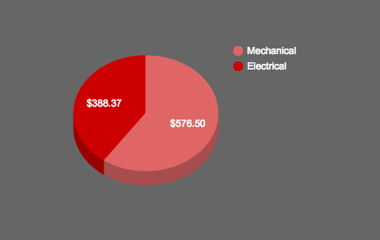
Division of Budget
AS IS | Total
Mechanical | $576.50
Electrical | $388.37
Budget Remaining | $35.13
TESTING | Total
Mechanical | $365.16
Electrical | $576.50
Budget Remaining | $225.99
TOTAL | Total
AS IS | $964.87
TESTING | $774.01
Budget Remaining | $261.12
See Appendix

Slide 40
Issues
Issues
Balancing $1000 on demonstrated cost
Optimizing output pins on microcontrollers
Only two DC Motors for Manual Navigation
DC Motors with Encoders
Rival Zeus MXV-1200
Integrating Cross-Discipline

Slide 41
Acknowledgements
Red Team would like to give a special thanks to the University of Central Florida College of Engineering and Computer Science as well as Lockheed Martin Missiles and Fire Control Orlando for collaborating, funding, and setting up this senior design competition.
We would also like to thank the individuals listed below for their time and consultation services in assisting in our preliminary design and helping to assure our continual improvement:
Helmuth Bauer Ray Boettger
Timbrel Carson Ray Gardner
Brandon Slack Tom Vito
Steve Yenisch Don Harper
In addition to our consultants, we would like to recognize our individual sponsors and advisors for their guidance on this project:
Kenny Chen Jonathan Tucker
Dr. Mark Heinrich Dr. Jihua Gou
Dr. Mark Steiner Dr. Lei Wei
Regards,
Red Team

Slide 42
Questions?

Slide 43
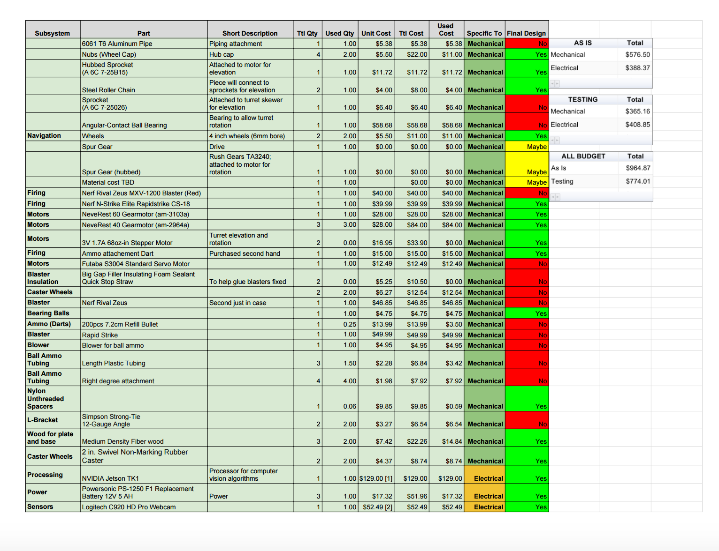
Appendix

Slide 44

Appendix

Slide 45

Appendix

